Slide 1

Capstone Project - The Battle of Neighborhoods: Boston’s Future
Submitted by: darko knezevic

Slide 2
Introduction
Boston is the capital of the U.S. state of Massachusetts.
Key facts:
A growing economy and a great place to acquire an education.
Some of the most prestigious schools within the U.S.A are located in Boston.
A lot of large companies are seeking to place their firms in Boston.
A global city that is placed among the top 30 most economically powerful cities in the world.
Boston's colleges and universities exert a significant impact on the regional economy.
Attracts hundreds of thousands of students from around the world, who contribute billions of dollars annually to the city's economy.
Highly innovative for a variety of reasons, including the presence of academia, access to venture capital, and the presence of many high-tech companies. Tourism also composes a large part of Boston's economy.

Slide 3
Problem Statement
The amount of crime needs to be understood for Boston to continue to thrive as a major hub for innovation, tourism, academia, and employment.
If the Boston Police Department knew more about which areas to concentrate on, then Boston’s citizens, tourists, and students would feel much safer.
Certain areas within the city could be targeted for more protection by the Boston Police Department based on data.

Slide 4
Objective
The project aims to select the safest and least safest areas in Boston based on the total crimes, explore the venues in these areas and finally cluster the areas using k-mean clustering.
The report will be targeted to the Boston Police Department who are looking to analyze crime incidents, as the city continues to be a leader in so many fields.
The crime statistics will provide an insight for the Boston Police Department towards their approach in dealing with different areas of city.
The most common venues in the safest areas will be explored.

Slide 5
Data
Based on definition of our problem, factors that will influence our decision are:
The total number of crimes committed in each major area during the most recent year available. For example, acquiring data from the most recent year available will be done to do analysis.
The most common venues in the area that is the safest.
The total amount of crime that have been committed from the year 2015 to 2018 will be analyzed for clustering purposes. More data will allow for more data analysis to be done.
Following data sources will be needed to extract/ generate the required information:
Preprocessing a real-world data set from Kaggle showing the Boston Crimes from the last few years. Kaggle, a subsidiary of Google LLC, is an online community of data scientists and machine learning practitioners. Kaggle allows users to find and publish data sets, explore and build models in a web-based data-science environment, work with other data scientists and machine learning engineers, and enter competitions to solve data science challenges.

Slide 6
Data Continued
The Boston crime file provides information about the following:
Data Set URL: https://www.kaggle.com/AnalyzeBoston/crimes-in-boston
INCIDENT_NUMBER | YEAR | LOCATION
OFFENSE_CODE | MONTH
OFFENSE_CODE_GROUP | DAY_OF_WEEK
OFFENSE_DESCRIPTION | HOUR
DISTRICT | UCR_PART
REPORTING_AREA | STREET
SHOOTING | LATITUDE
OCCURRED_ON_DATE | LONGITUDE

Slide 7
Methodology
Data Cleansing:
From the Boston crime data, the data from the year 2018 was initially analyzed to understand key drivers in the most recent year. However, as the study progressed in order to effectively do k-means clustering more data from previous years was required.
All the data values that didn’t have a district associated with an incident were removed from the dataset for certain types of analysis.
Missing data were coming from reporting area, latitude and longitude.

Slide 8
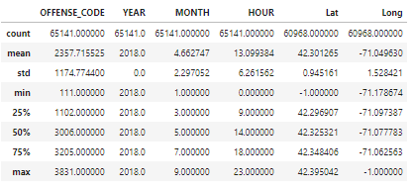
Statistical Summary of Crime in 2018
Approximately 65,141 crime were identified in the City of Boston that have been assigned to a police district in 20180

Slide 9
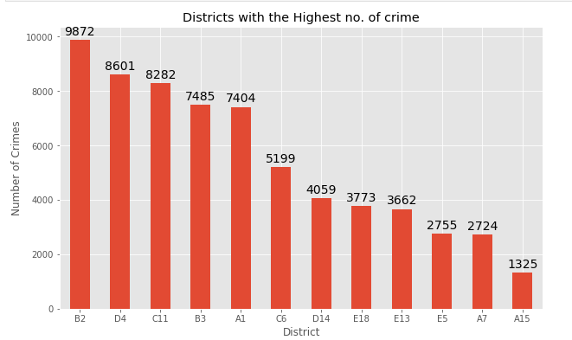
Exploratory of Data
The top five districts were the most crime occurs is at B2, D4, C11, B3, A1 in 2018.
Most of the crime that is occurring is located in the middle of the Current Boston Police Districts Map.

Slide 10
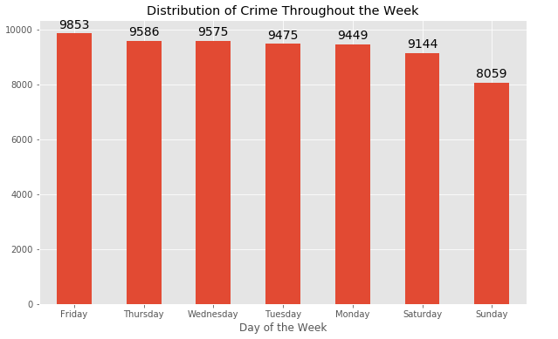
Exploratory of Data Continued
More crime occurs as the week goes on from Monday to Friday with a reduction in the amount of crime during the week in 2018.

Slide 11
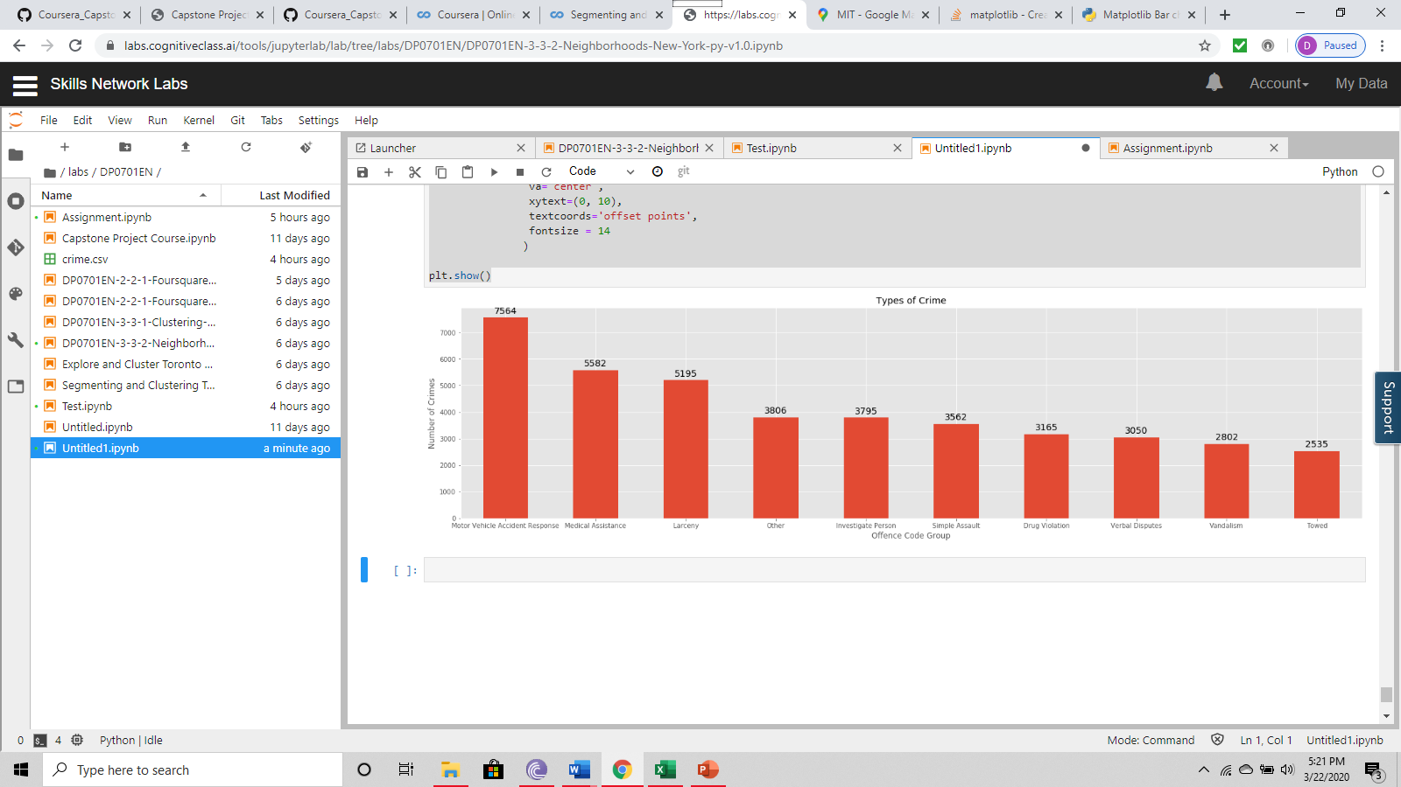
Exploratory of Data Continued
A large spike in the amount of crimes have been related to motor vehicle accident response, medical assistance, and latency in 2018.

Slide 12
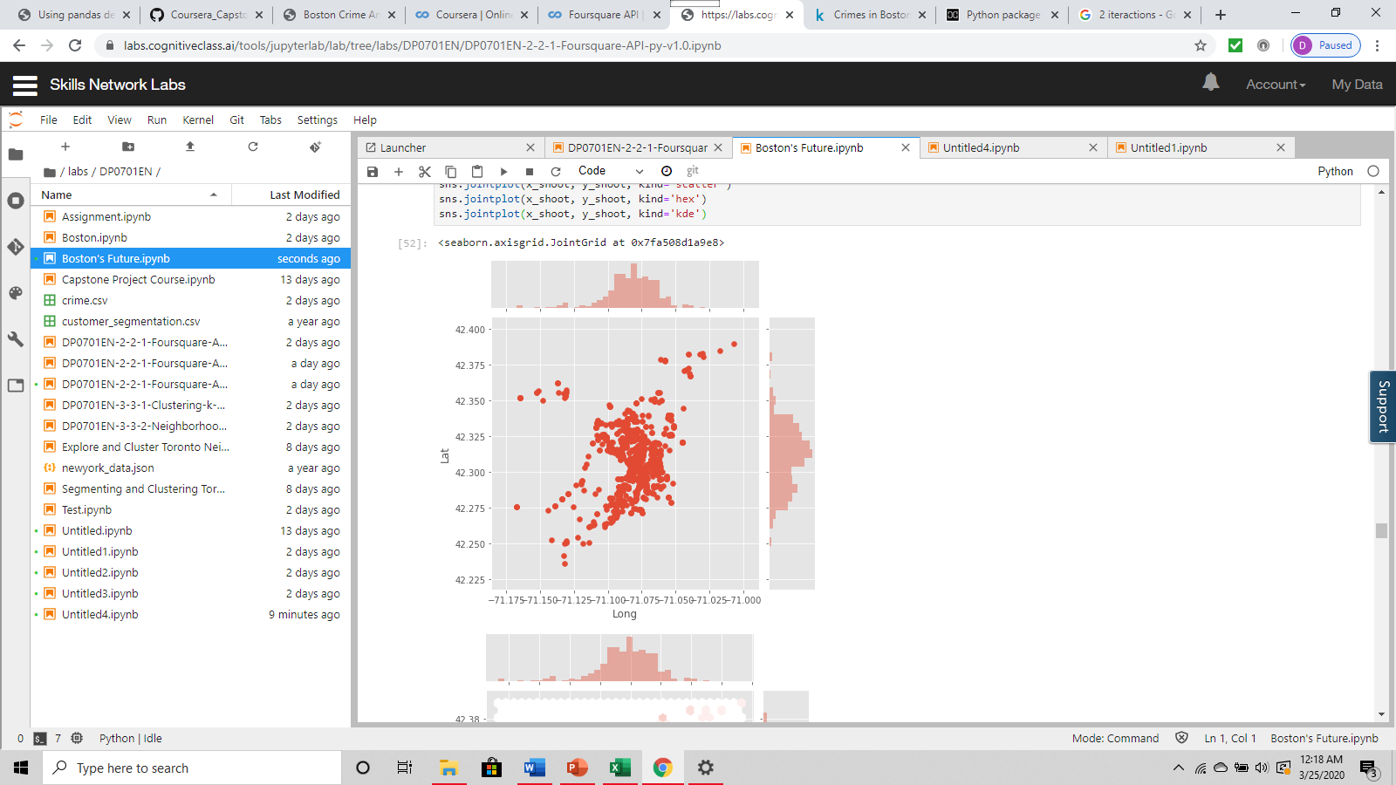
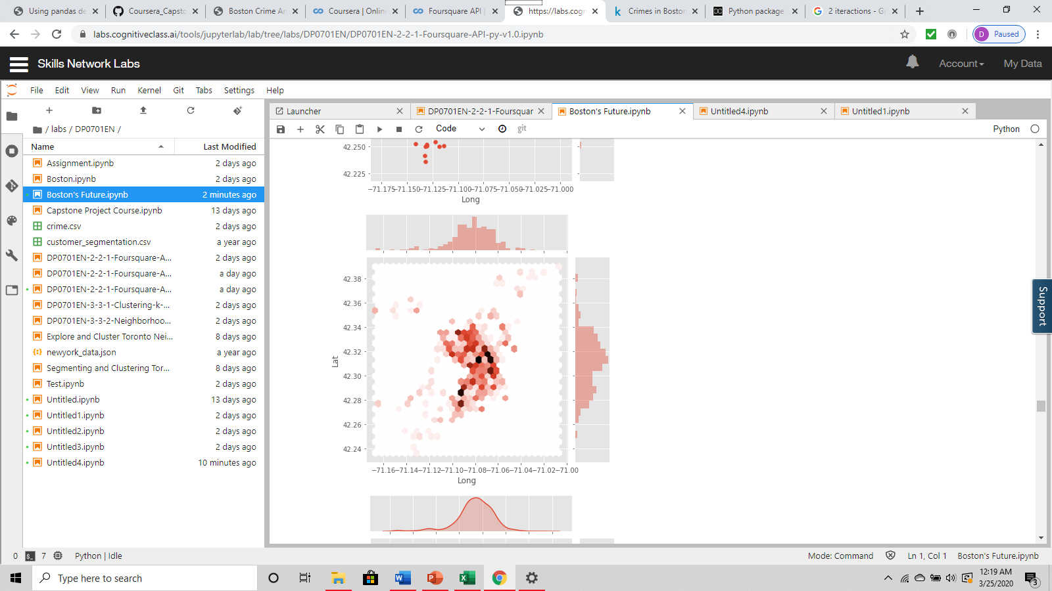
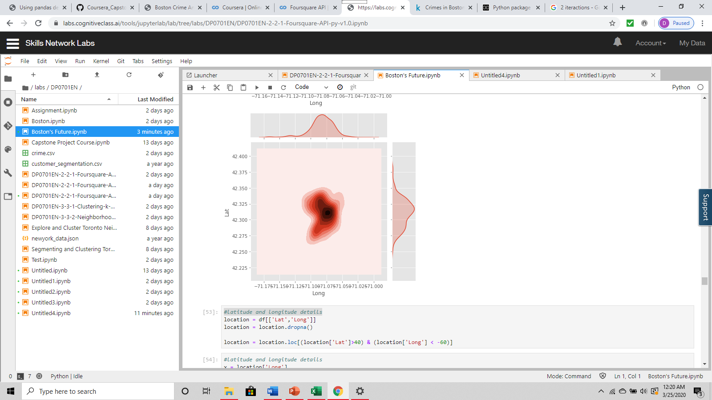
Exploratory of Data Continued
Most of the shooting in Boston from 2015 to 2018 have been located in the centre of the Boston Police Districts.

Slide 13
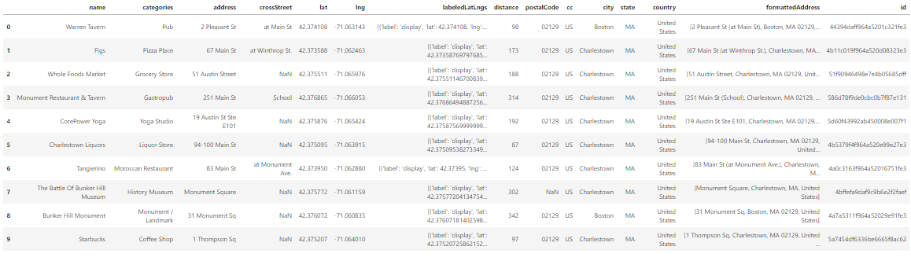
Common Venues in the Safest Area – A15 (Charlestown)

Slide 14
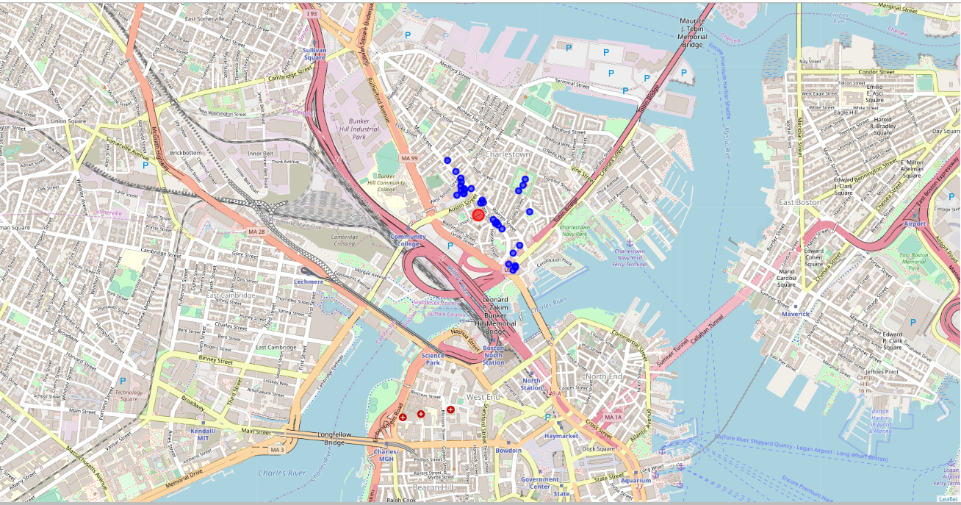
Common Venues in the Safest Area – A15 (Charlestown)

Slide 15
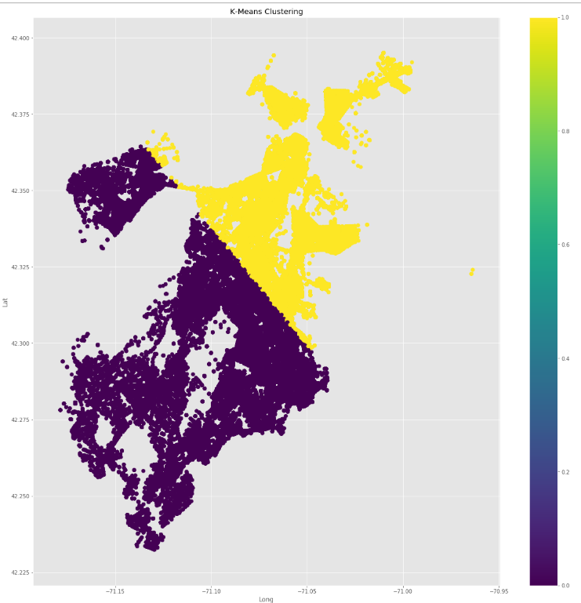
Crime into Two Clusters from 2015 to 2018

Slide 16
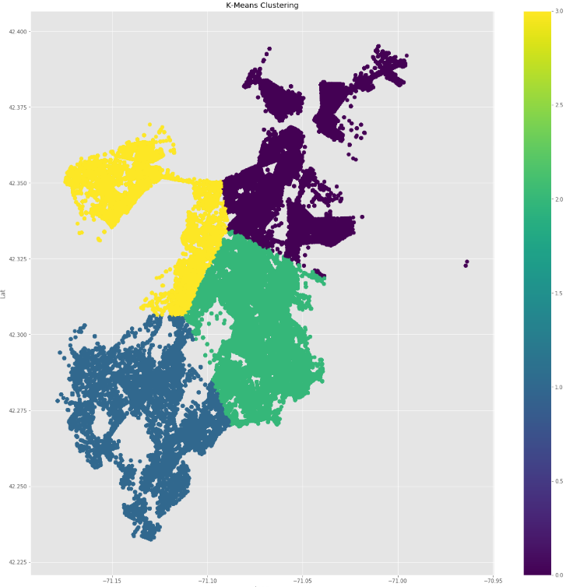
Crime into Four Clusters from 2015 to 2018

Slide 17
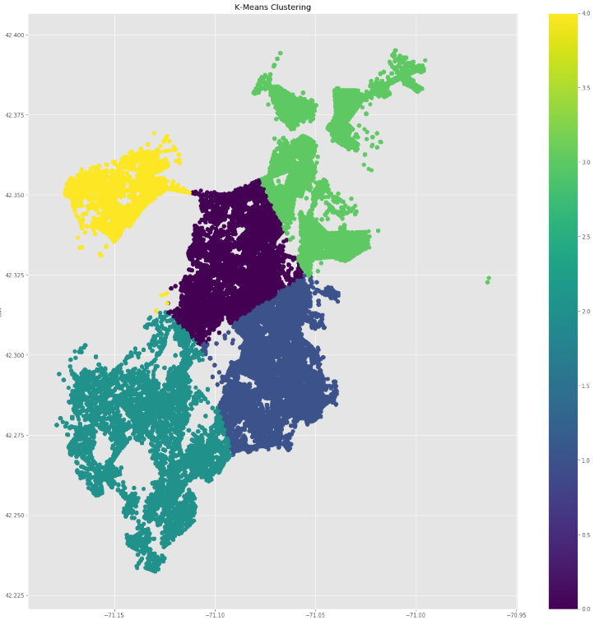
Crime into Five Clusters from 2015 to 2018

Slide 18
Conclusion
Key Points:
Most crime occurs is at B2, D4, C11, B3, A1
Certain venues were closely linked to drug problems and violent crime
Motor-Vehicle accident response were the highest number of report registered with the Boston Police.
The k-means clustering of the crime data from previous years has indicated that the north part of the police districts have less crime.
This analysis can help Boston Police act accordingly and try to reduce the crimes frequently occurring in the city of Boston.

Slide 19
Appendix

Slide 20
Legend: Current Boston Police Districts Map
This report will also make reference to the Department’s various police
districts The districts include A1(Downtown, Beacon Hill, North End, and Chinatown), A7 (East
Boston),A15 (Charlestown), B2 (Roxbury and Mission Hill), B3 (Mattapan and portions of Dorchester), C6 (South Boston), C11 (Dorchester), D4 (Back Bay, South End, and Fenway), D14 (Allston and Brighton), E5 (West Roxbury and Roslindale), E13 (Jamaica Plain), and E18 (Hyde Park).

Slide 21
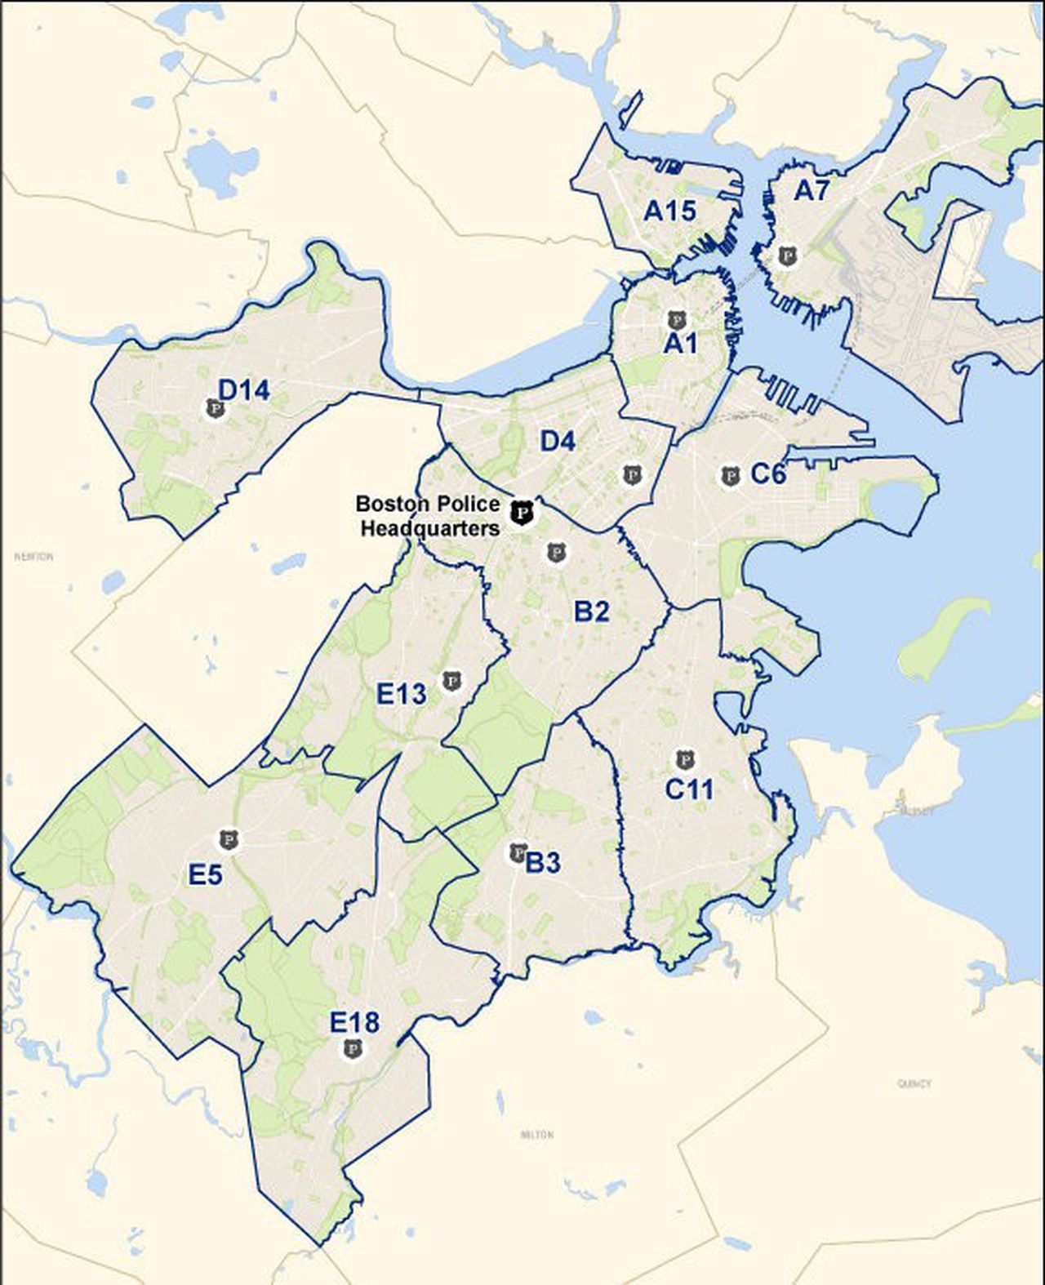
Current Boston Police Districts Map

Slide 22
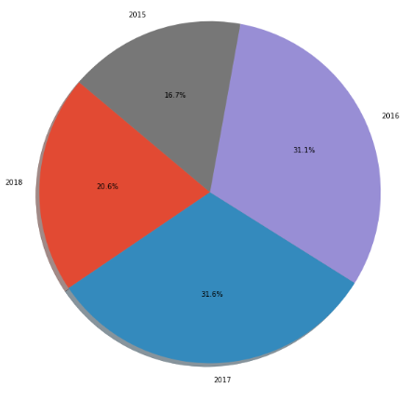
The Percentage of Crime from 2015 to 2018

Slide 23
Thank you
- Darko Knezevic

